Slide 1









Infosys Springboard Internship 5.0
Voice Based Patient Call System
Presented by-
Team
B3 batch
Mentor-
Ms.Shilpee

Slide 2





WHY IS IT NEEDED ?
Delayed response time
Faster Response
Insufficient Workflow
Real-Time Alerts
Outdated Call Systems
Voice Based Assistence

Slide 3

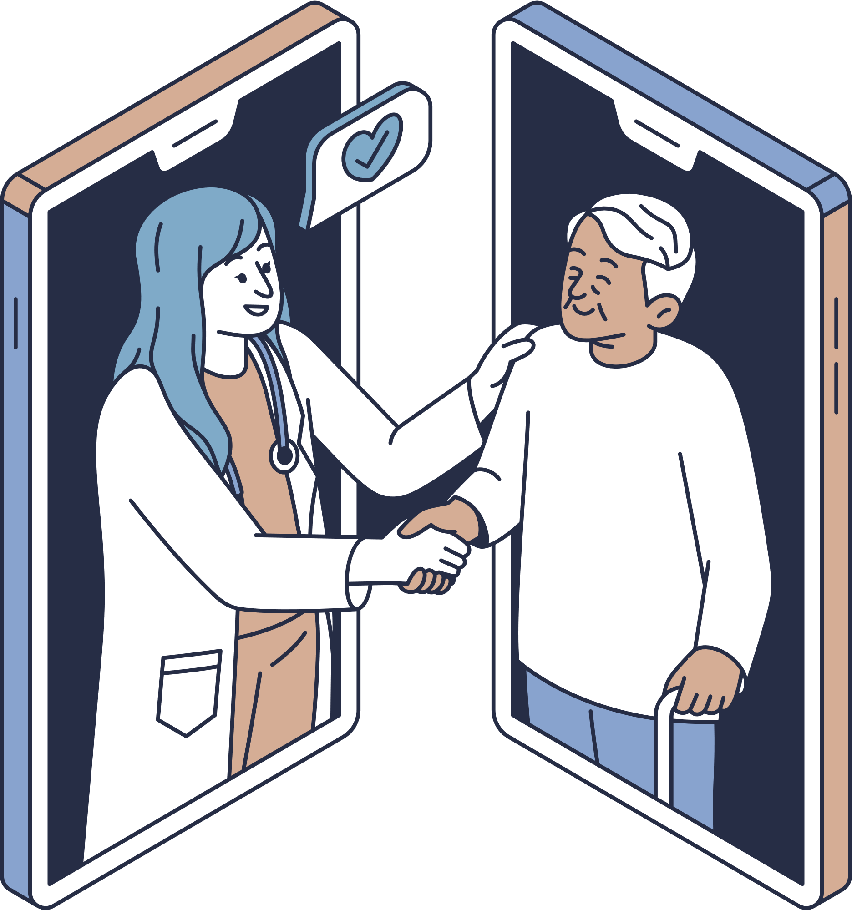
OBJECTIVES
Fast Communication Channel
AI-Powered Prioritization
A robust communication infrastructure for real-time interaction between patients and healthcare providers.
Utilizing AI algorithms to analyze patient data and dynamically prioritize their needs.
Real-time Tracking and
Notifications
Enables healthcare providers to monitor patient status and receive timely alerts for critical situations.

Slide 4
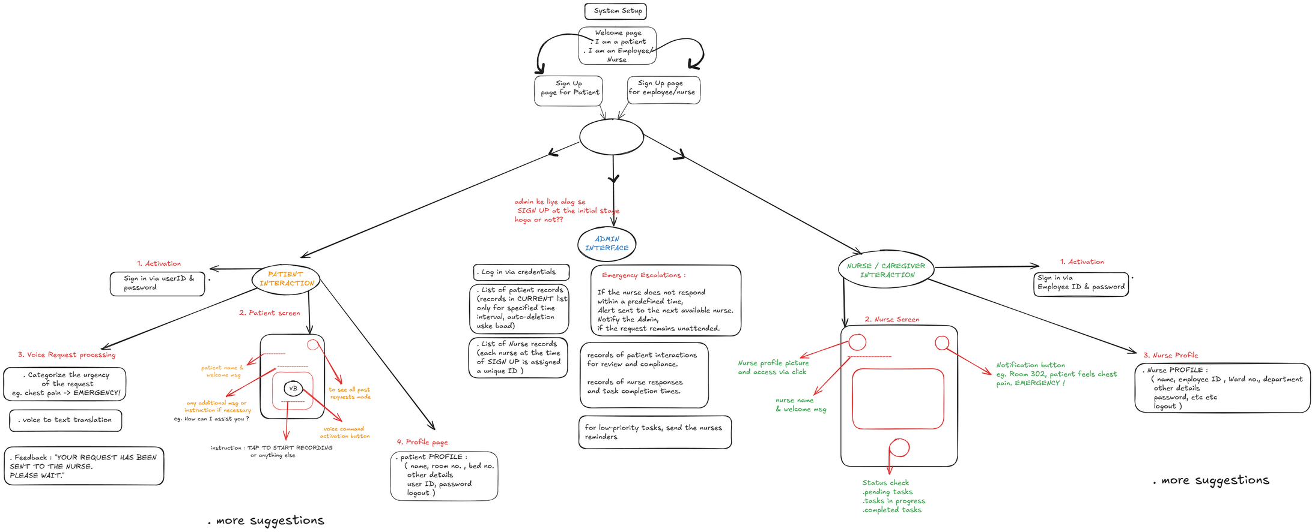
USER FLOW

Slide 5









Care Connect
Voice-Based Patient Calls
Instant Alerts for Nurses & Caregivers
Request classification to High, Medium and Low
User-Friendly Mobile Interface
Role-Based Login for Patients & Nurse
Effortless communication for better patient care
Speech Services Integration
WELCOME TO
CARE CONNECT
NLP-Powered Request Analysis

Slide 6
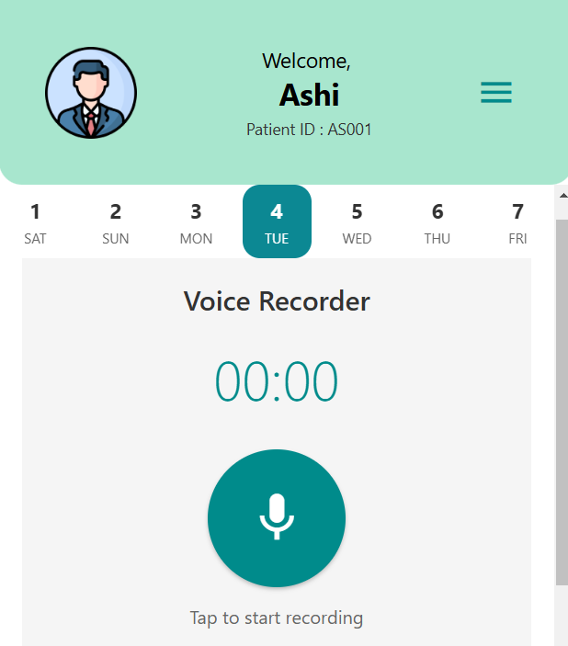
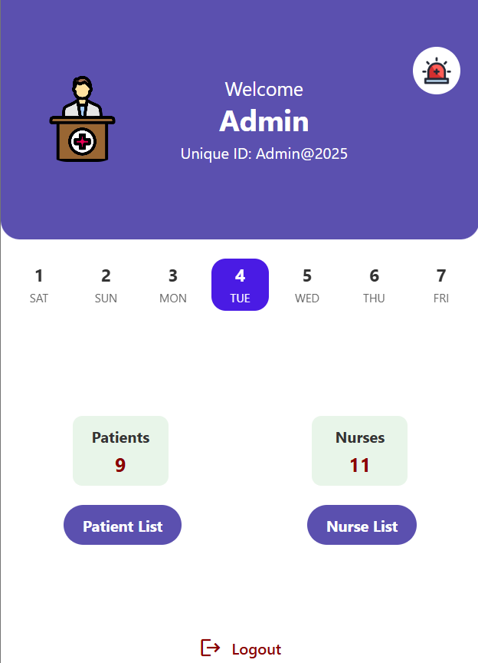
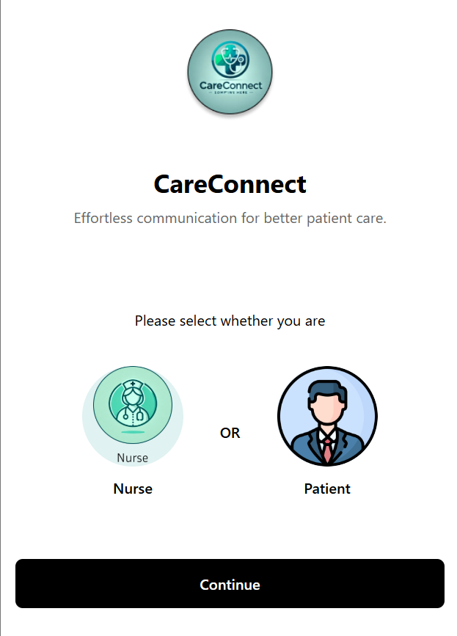
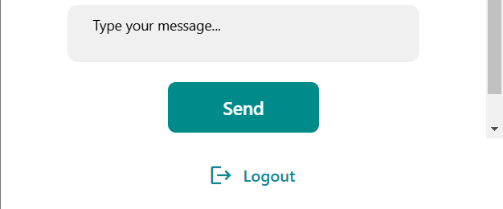
APP UI

Slide 7








TECH STACK
Figma
Node Js
App UI designing
Building Back-end server
Reactive Native
Azure
Front-end development
AI, NLP, speech to text
Expo Go
MongoDB
Bundling the app
Backend Data storage
Express JS
Android Studio
Creating RESTful APIs
Testing & debugging

Slide 8
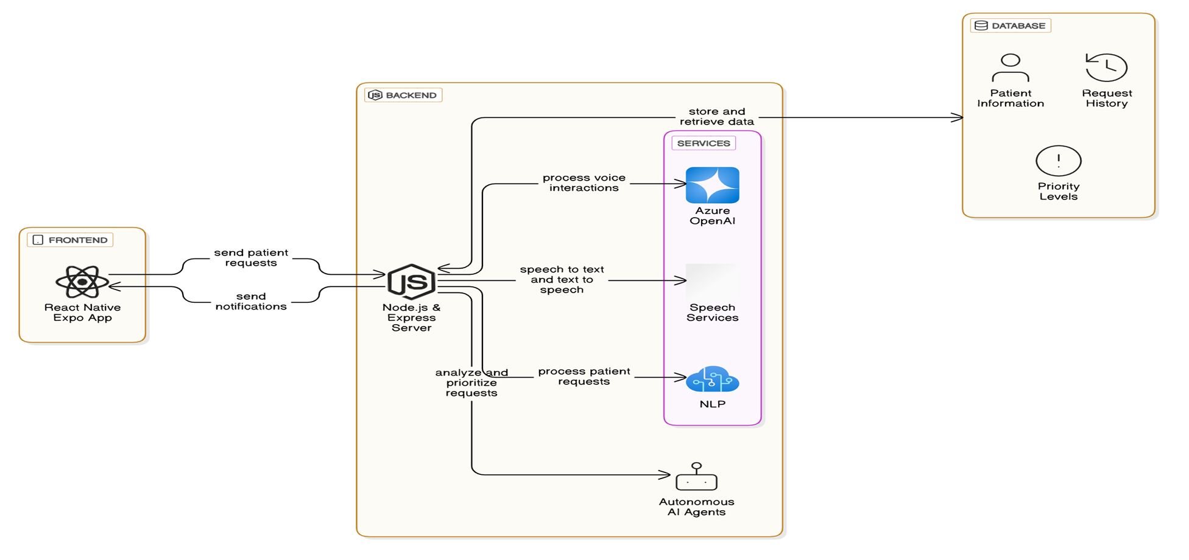
SYSTEM DIAGRAM

Slide 9



CHALLENGES
Challenges
Accurate Speech
Medical Jargon
Scalable Database
Displaying Real-time Requests
Solutions
Azure Speech Services
Fine-tuned the NLP model
MongoDB Atlas with flexible schema

Slide 10





Multi-Language Support : Extend the app to support multiple languages, catering to patients from diverse linguistic backgrounds.
AI-Powered Predictive Alerts : Implement machine learning models to predict emergencies based on patient health data trends, generate proactive alerts and recommend preventive measures.
SCOPE
Integration with IoT Hospital Systems : Connect with IoT devices like patient monitors and wearables to provide real-time health updates and automated alerts.
Virtual Assistant for Chronic Conditions :
Provide personalized support and guidance for patients with chronic conditions.

Slide 11

Thank you for your attention

